Slide 1
Analyzing sentiment of
tweets from U.S. universities
Ruma Anand, Ryan Miller, Daniel Trielli
Social Media Mining / Spring 2018

Slide 2




Overview
Academic excellence
Reputation
Financial outcome
Quality of life
Notes:
Daniel

Slide 3


Motivation
Use sentiment of social media chatter related to
universities as an indication of quality of life on campus
1 | Northwestern University
2 | Harvard University
3 | Johns Hopkins University
4 | Cornell University
5 | Stanford University
Notes:
Daniel

Slide 4
Related work on sentiment and social media
"Analyzing and understanding societal response and crowd reaction to important and emerging social issues and events through social media data is increasingly an important problem."¹
Emotion miners can be used to detect sentiment/emotion associated with a social media post. Vast amount of data is available on social media as people continue to share feedback about products and their experiences.²
¹ Paul, D., Li, F., Teja, M. K., Yu, X., & Frost, R. (2017, August). Compass: Spatio Temporal Sentiment Analysis of US Election What Twitter Says!
² Krebs, F., Lubascher, B., Moers, T., Schaap, P., & Spanakis, G. (2017). Social Emotion Mining Techniques for Facebook Posts Reaction Prediction.
Notes:
Daniel

Slide 5
Research questions
RQ1: Is it possible to classify universities according to sentiment?
RQ2: Does this classification provide robust insights about quality of life on campus?
Notes:
Daniel

Slide 6
Methods
Notes:
Ruma

Slide 7
Methods: overview
Create a sample of American universities
Collect tweets from those universities
Run sentiment analysis on these tweets
Notes:
Ruma

Slide 8
Methods: overview
Create a sample of American universities
Collect tweets from those universities
Run sentiment analysis on these tweets
Notes:
Ruma

Slide 9
Methods: sample of universities
Similar to Northwestern
Association of American Universities has 60 institutions
We sampled universities that had between 15,000 and 25,000 students
Institution | Control | Total students | State | U.S. Region
Cornell University | Private | 21,904 | New York | Northeast
Harvard University | Private | 21,000 | Massachusetts | Northeast
Johns Hopkins University | Private | 23,073 | Maryland | South
Northwestern University | Private | 21,208 | Illinois | Midwest
Stanford University | Private | 15,877 | California | West
University of California, Santa Barbara | Public | 24,346 | California | West
University of Oregon | Public | 22,980 | Oregon | West
University of Pennsylvania | Private | 24,630 | Pennsylvania | Northeast
University of Virginia | Public | 22,391 | Virginia | South
Notes:
Ruma
Aiming for similarity with Northwestern University
Decided use the list from AAU, the Association of American Universities, an organization of 60 leading universities in North America
Selected the ones that were similar to NU
That sample is also appropriate because it has a mix of private/public insitutitions and all US regions are represented. Not biased.

Slide 10
Methods: overview
Create a sample of American universities
Collect tweets from those universities
Run sentiment analysis on these tweets
Notes:
Ruma

Slide 11
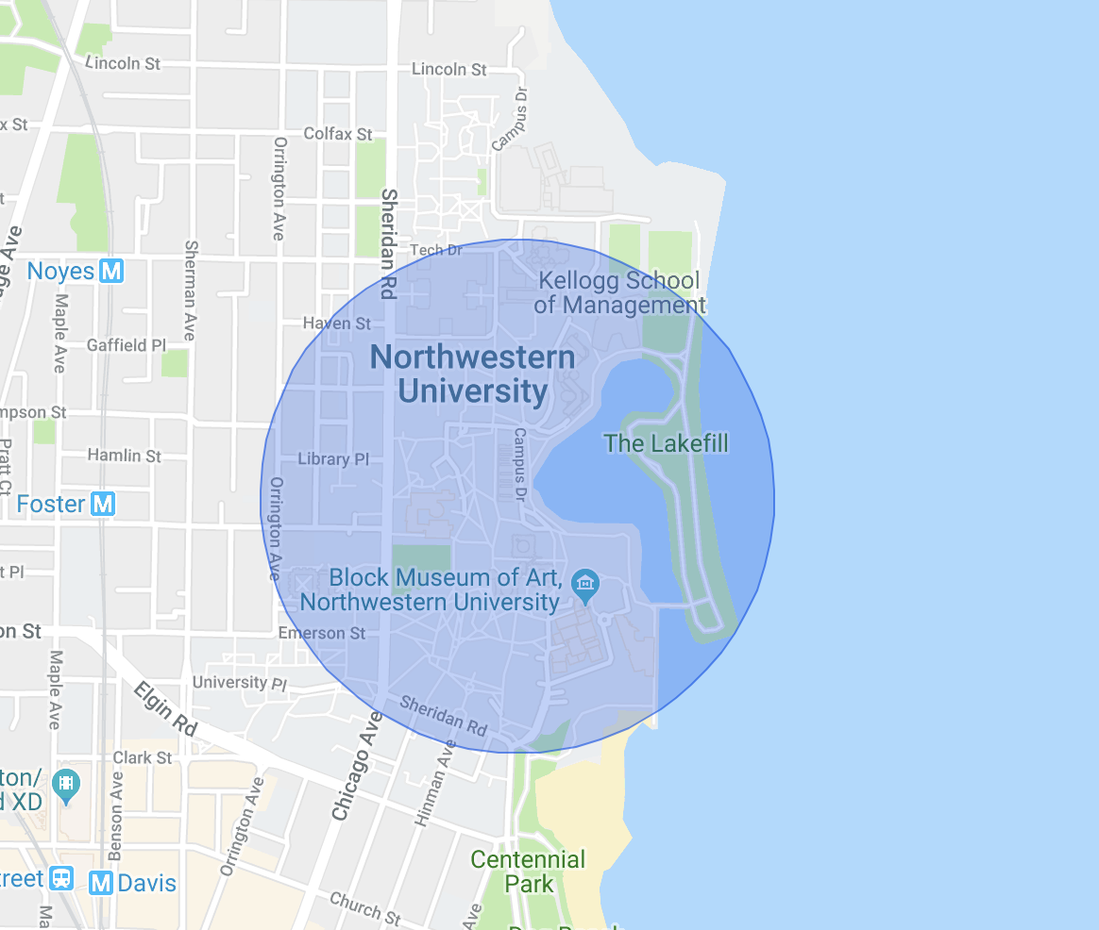
Methods: data collection & treatment
Notes:
Ruma
Different radia for each university (NU is .3 miles; largest it's .7 miles)
Each campus is different
Approximation because of shape

Slide 12

Methods: data pre-preprocessing
Data Collection
Twitter’s search API limitations
Data Treatment -
Remove Hyperlinks
Unicode characters causing noise
Standardized the data
Notes:
Ruma
Different radia for each university (NU is .3 miles; largest it's .7 miles)
Each campus is different
Approximation because of shape

Slide 13
Methods: overview
Create a sample of American universities
Collect tweets from those universities
Run sentiment analysis on these tweets
Notes:
Ryan

Slide 14

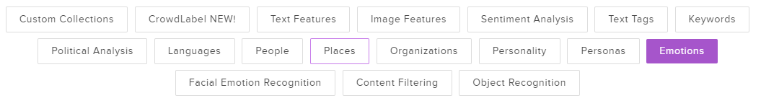
Methods: sentiment analysis
Notes:
Ryan

Slide 15
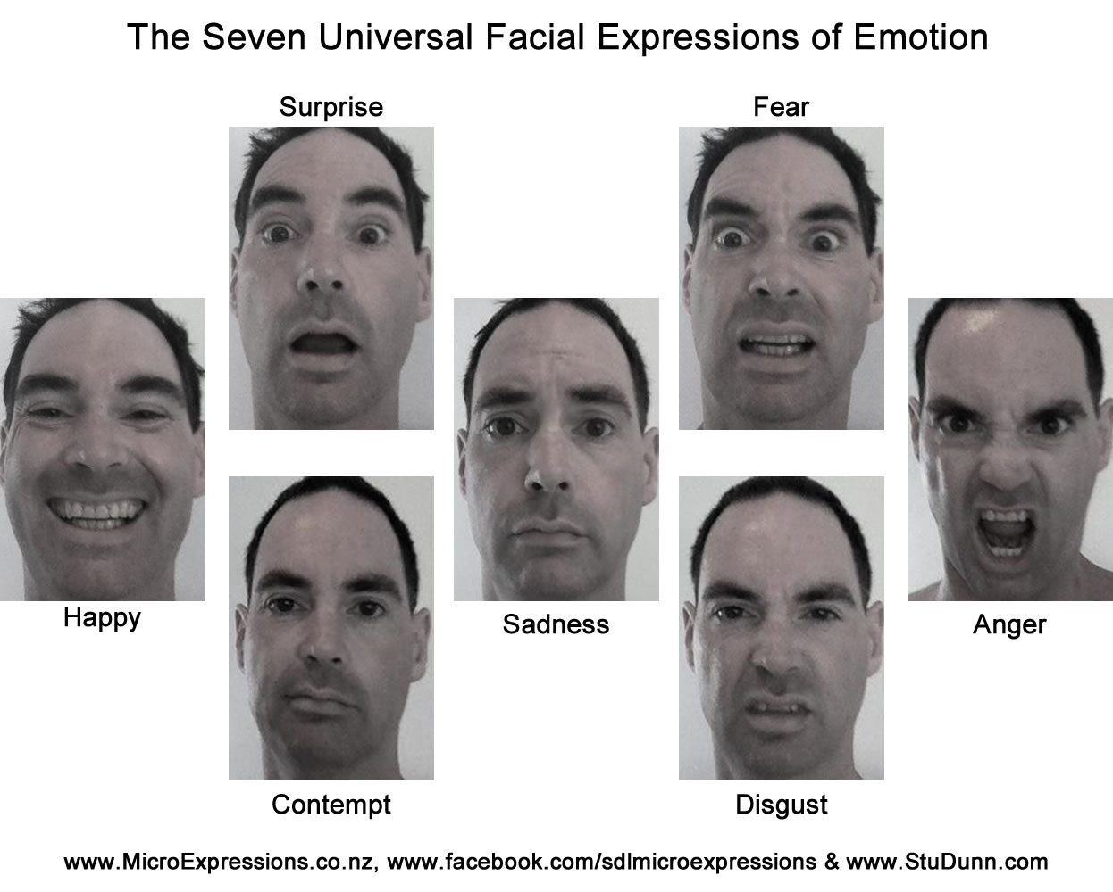
Eckman’s Six… or five? Maybe seven?
Notes:
Ryan

Slide 16
Methods: sentiment analysis
"I did it. I got into Grad School. Not just any program, but a GREAT program. :-)"
anger: 0.007581697776913643
joy: 0.8000516891479492
fear: 0.07016664743423462
sadness: 0.025123804807662964
surprise: 0.0970761775970459
"Like seriously my life is bleak, I have been unemployed for almost a year."
anger: 0.13750846683979034
joy: 0.12738963961601257
sadness: 0.6145485639572144
fear: 0.09026515483856201
surprise: 0.03028818964958191
Notes:
Ryan

Slide 17
Initial results
Notes:
Ryan

Slide 18
Initial results
 | anger | joy | fear | sadness | surprise
Cornell University | 0.08102445 | 0.43095239 | 0.20737744 | 0.10785008 | 0.17279563
Harvard University | 0.19456264 | 0.24016375 | 0.19760925 | 0.22179864 | 0.14586575
Johns Hopkins University | 0.07775893 | 0.32961827 | 0.18067867 | 0.16613033 | 0.24581378
Northwestern University | 0.15131454 | 0.2027593 | 0.21846451 | 0.17503815 | 0.25242351
Stanford University | 0.10393741 | 0.27993257 | 0.13037034 | 0.22653241 | 0.25922725
University of California, Santa Barbara | 0.1655255 | 0.43099737 | 0.13332123 | 0.10719271 | 0.16296319
University of Oregon | 0.10005194 | 0.40553657 | 0.2344685 | 0.12236296 | 0.13758004
University of Pennsylvania | 0.09029441 | 0.31531284 | 0.23659984 | 0.09774677 | 0.26004617
University of Virginia | 0.16565183 | 0.41640081 | 0.23081278 | 0.09805582 | 0.08907878
Average | 0.1255690722 | 0.3390748744 | 0.1966336178 | 0.1469675411 | 0.1917549
Notes:
Ryan
Northwestern doesn't top any ranking, but it is angrier, less joyful, more fearful, sadder and more surprise than the average

Slide 19
Initial results: caveats
Original goal was to collect one year of tweets
However, Twitter API limits it to one week
Limited number of tweets per university gives us very incomplete view
Alternatives:
Use a database of older tweets, filtered by geolocation
Use a library that allows collection of older tweets
Notes:
Ryan

Slide 20
Discussion
Notes:
Daniel

Slide 21
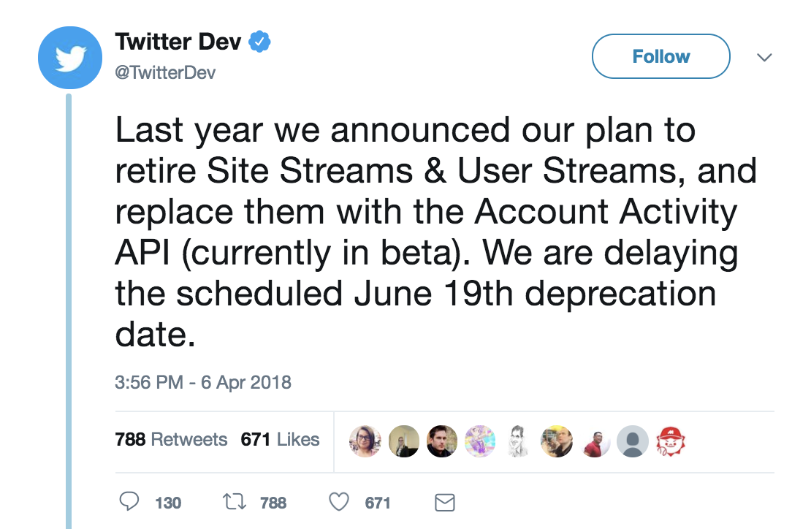
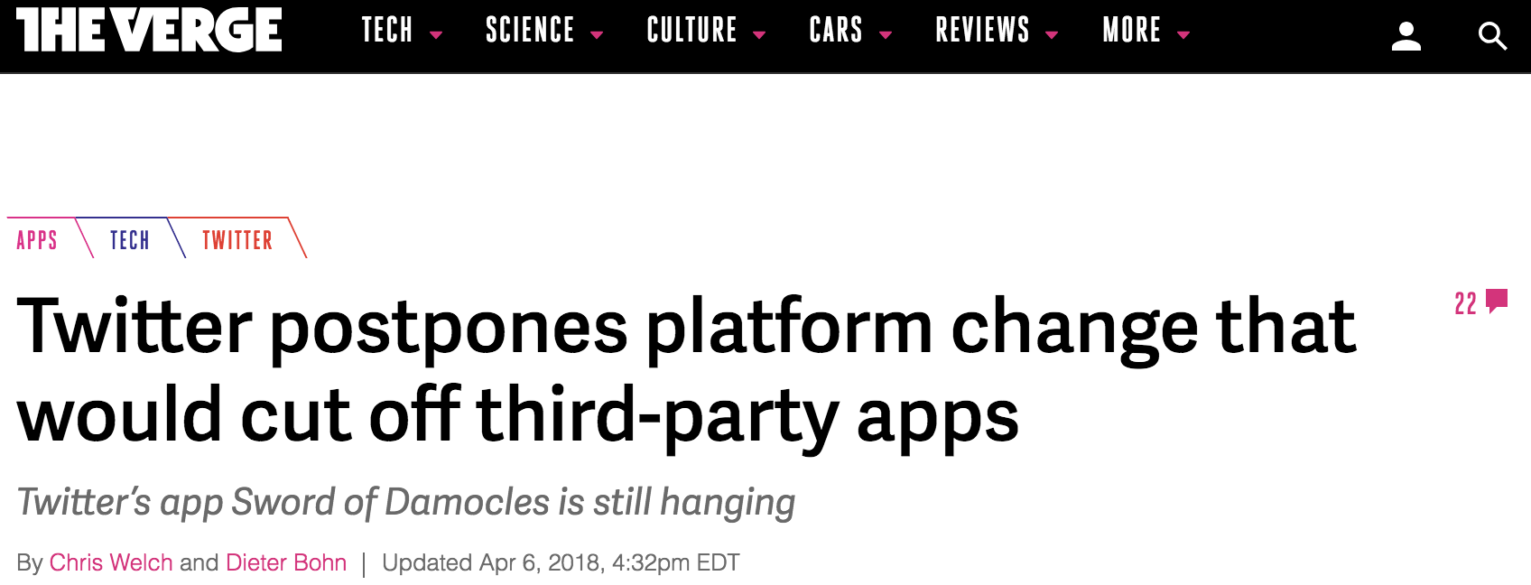
What the results (and limitations) show us
Sentiment requires high volume of data (but that can also normalize trends)
Reliance on Twitter API is problematic
Notes:
Daniel

